Slide 1


JNTUH COLLEGE OF ENGINEERING MANTHANI
Department of Computer Science and Engineering
E.A.S.T
Electronic Anti-(Suffocation & Temperature)
Under the guidance of
Dr. K. Shahu Chatrapati, Asst. Professor and HOD of CSE,
Dept. of Computer Science and Engineering, JNTUH College of Engineering Manthani.
B. Bhanu Prakash (15VD5A0501) Adarsh Gautam (14VD1A0501) Syed Thowfeeq Ahmed (14VD1A0551)

Slide 2
CONTENTS
ABSTRACT
MOTIVATION
STATISTICS
PRESENT SOLUTION
PROPOSED SOLUTION
TECHNOLOGIES USED
WORKING DESCRIPTION
VISUALISATION AND SCREENSHOTS
CONCLUSION
BIBLIOGRAPHY

Slide 3
ABSTRACT
It is an IOT device which serves as both Alerting system which alerts the user when there is an emergency as well as an environment monitoring system.
If someone’s presence is detected along with abnormal conditions in vehicle then an immediate notification (SMS) will be sent to the vehicle owner alerting the user.
It silently monitors interior conditions of the vehicle and alerts about dangerous yet unnoticed things such as changing AC filter.

Slide 4
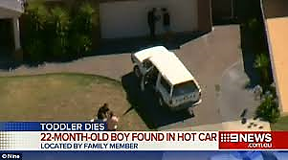
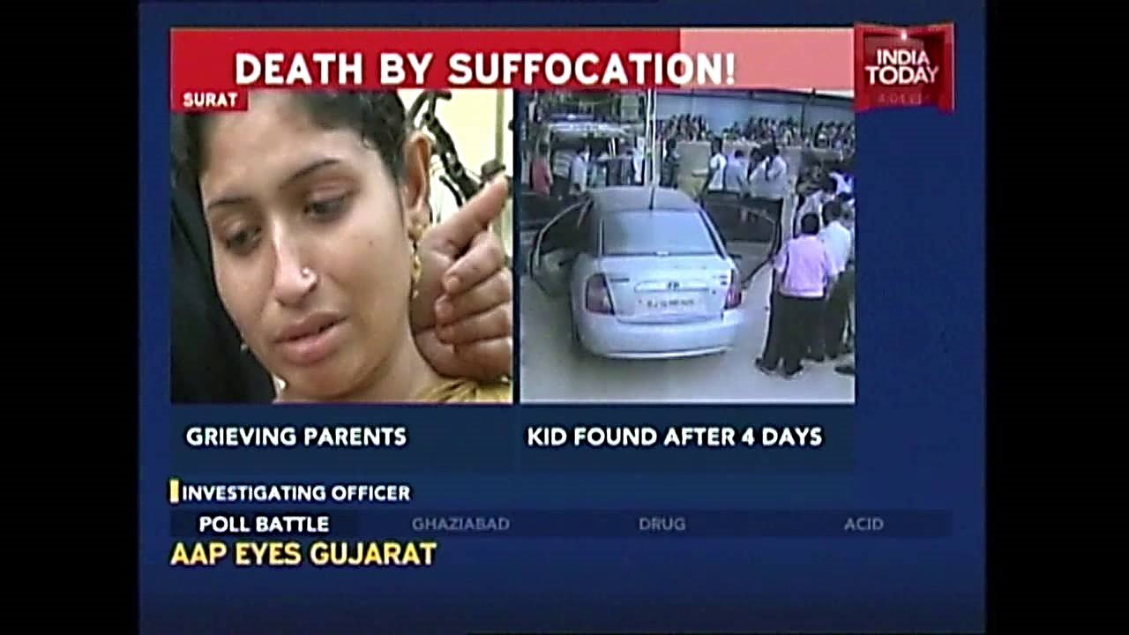




MOTIVATION

Slide 5
PROBLEMS IDENTIFIED
The death of toddlers, disabled people and animals due to suffocation in locked cars.
On an average, 49 children die in hot cars each year.
It takes 10 minutes for the temperature in a car to go up 20 degrees Fahrenheit.
A child’s body temperature can rise up to five times faster than an adult’s.

Slide 6
STATISTICS
INDIA:Average number of child heatstroke fatalities per year since 1998- 49

Slide 7
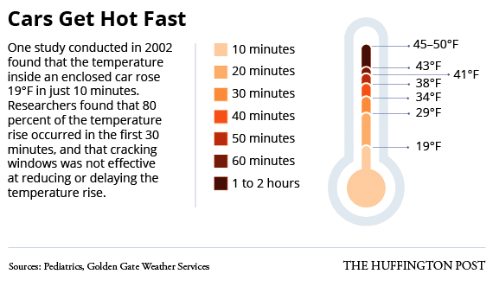
STATISTICS (cont...)

Slide 8
PRESENT SOLUTION
Special seats are designed to monitor heartbeat in the presence of baby.
There are a few aftermarket warning systems, such as the Childminder Smart Clip System, which alerts a parent if they’ve inadvertently wandered away from a child left in a safety seat or shopping cart or somewhere else, But their efficiency is questionable.
RESEARCH A Mechatronic System to Prevent Death due to Suffocation in a Locked Car (based on temperature sensors) By IRA-International Journal of Technology & Engineering

Slide 9
PROPOSED SOLUTION
It is an IOT device which serves both as an alerting system which alerts the user when there is an emergency as well as an environment monitoring system.
Temperature sensor and CO2 sensors are continuously running and monitoring the status of the vehicle and also updating it to cloud for later reference.
If someone’s presence is detected along with abnormal conditions in vehicle then an immediate notification (SMS) will be sent to the vehicle owner alerting the user.

Slide 10

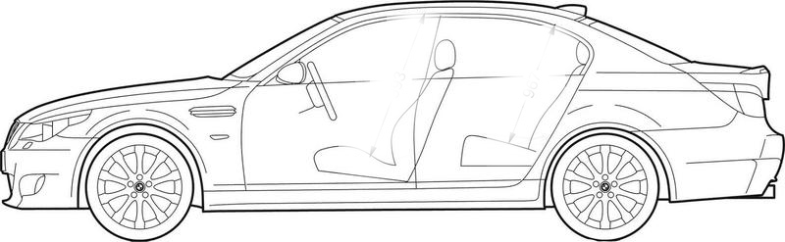

PROPOSED SOLUTION (cont…)
CLOUD
Carbon-dioxide and temperature sensor
Motion sensor
ALARM
User
Notification

Slide 11
TECHNOLOGIES USED
1. Sensors used
Carbon gas sensor (MQ135)
Temperature sensor (DHT11)
Motion sensor (HC SR501 PIR)
2. Raspberry Pi-3 along with Raspbian OS
3. Python programming language
4. Cloud Storing (Thingspeak)
5. Android Application (Thunkables)
6. Data visualizations using cloud

Slide 12
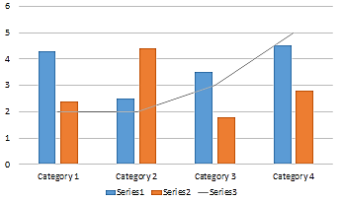
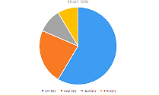

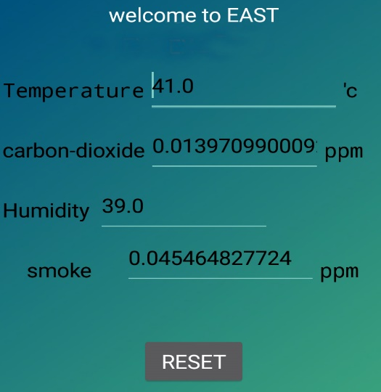
WORKING DESCRIPTION
Sequence of operation of the system The following flow chart shows the sequence of operation of the system
Cloud
Start
Carbon-dioxide sensor
(Level increasing)
Temperature
(Level increasing)
Motion Sensing
Raspberry Pi
Notification
via SMS
Alarm

Slide 13
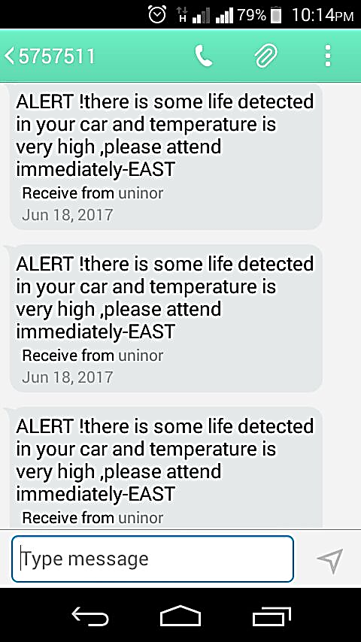

SMS ALERT
This may enable you to reach somebody quicker than via email and instant messaging
Text messages do not require an Internet connection

Slide 14
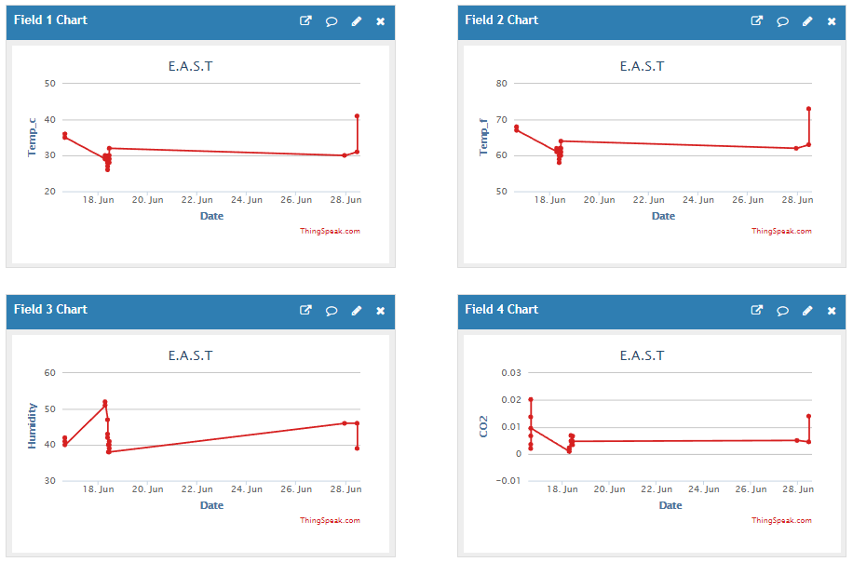
ANALYTICS IN-CLOUD

Slide 15

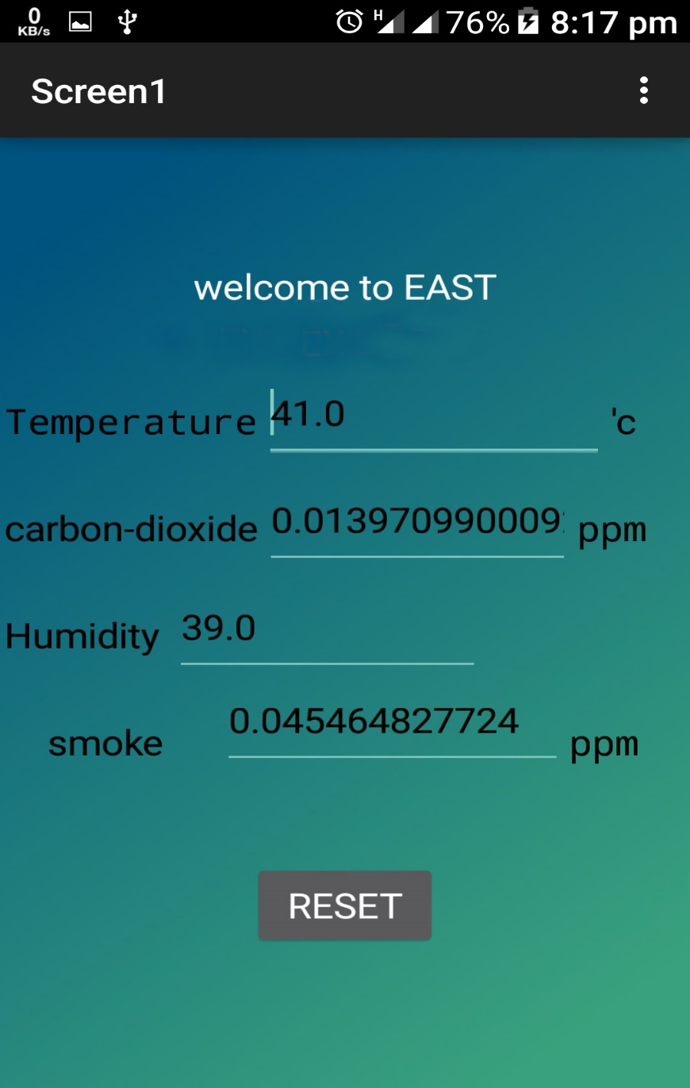

ANDROID APPLICATON
It is simple to use and understand
This application give access to real time gases and temp reading form the device .

Slide 16
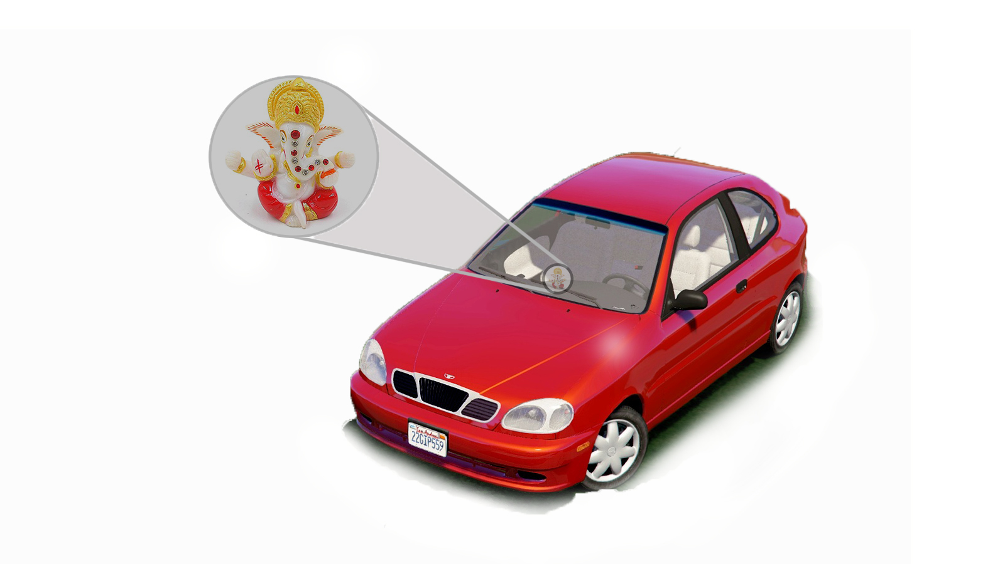
CONCLUSION

Slide 17
BIBLIOGRAPHY
Raspberry Pi
https://www.raspberrypi.org/forums/viewtopic.php?t=69427&p=505235
News Cuttings
http://fox5sandiego.com/2017/07/18/baby-died-in-hot-car-while-georgia-mom-got-her-hair-done-police-say/
http://www.theindychannel.com/news/call-6-investigators/call-6-coroner-child-suffocated-at-lafayette-day-care
http://timesofindia.indiatimes.com/city/bengaluru/Kids-2-4-get-locked-in-car-die-of-suffocation/articleshow/46870443.cms
Stats
http://noheatstroke.org/
https://www.nbcnews.com/storyline/hot-cars-and-kids/death-hot-cars-facts-figures-prevention-n153776
San Francisco State University, Department of Geoscience. 2015, Cause of heatstroke deaths in car. Available from: http://www.ggweather.com/heat/index.htm
Garethiya et al., 2015. Affordable System for Alerting, Monitoring and Controlling Heat Stroke inside Vehicles. International Conference on Industrial Instrumentation and Control (IClC), College of Engineering Pune, India, 1506-1511.Texas instruments. 2016, LM 35 specification.Available from: http://www.ti.com/lit/ds/symlink/lm35.pdf .

Slide 18

OPEN TO QUERIES
Thank you

